Slide 1
WHAT IS AN INTELLIGENT POWER SWITCH?
Monolithic Fully Protected Power Stage and Control
Designed for Harsh Environment (-40°C .. +150°C )
Capability to drive any kind of Load
Exhaustive Diagnostics
5.5V < Operating Voltage Range < 55V
Supervisory Functions
Logic
&
Diagnostic
References
&
Supply
Input
Input Stage
Protected Driver
Out
Notes:
AN IPS (Intelligent Power Switch) is a device allowing to connect and disconnect a load (function similar to a relay) with some extra logic and safety functions. The input pins allow to turn on or off the transistor. Then, some safety features are added (like over voltage, short circuit or over temperature for instance) that will turn off the transistor (in other words, disconnect the load)

Slide 2
Intelligent Power Switch - Features
Short circuit and Over current
Protection
Under-voltage and
Over-voltage
Protection
ESD Protected
I.P.S.
IEC 61131-2
Compliant
Loss of ground
Protection
Open Load
detection
Fast
Demagnetization
Over-temperature
Protection
Notes:
This slide shows the safety features that can be integrated. The VNI2140J integrates Most of these features.

Slide 3
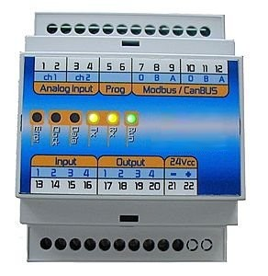
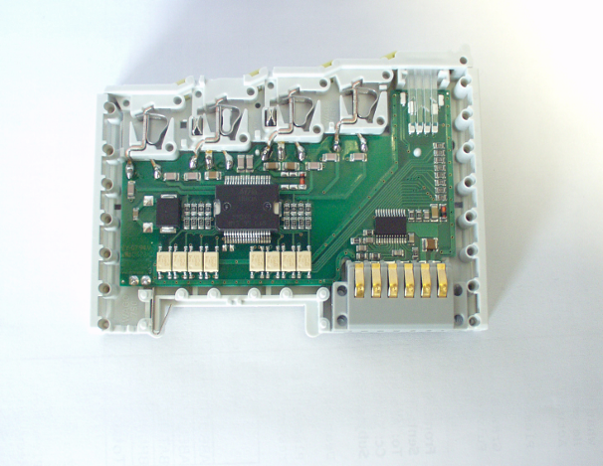
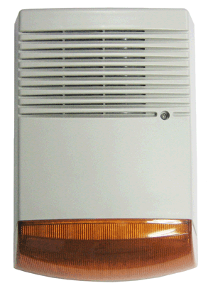
IPS MAIN APPLICATION FIELDS
Robotic
Programmable Logic Controller (PLC)
& Computer Numerical Control (CNC)
Elevator
Peripheral I/O
Alarm and Security Systems
Vending Machines
Notes:
An IPS is designed in stringent industrial applications. You find an IPS in an application where sensor inputs must trigger an actuator.

Slide 4
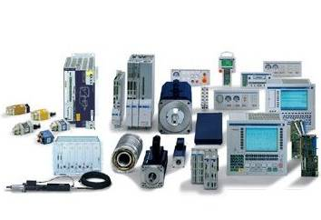
Intelligent Power Switch - Portfolio
VIPower
VN330SP
Quad HSS 200mΩ
PSO10
VN808/CM/SR
Octal HSS 160mΩ PSO36
VN340SP
VNI2140J
VNI8200XP
VNI8202XP(*)
VNI4140K
NEW Octal HSS+SPI 110mΩ PSS036
NEW Dual HSS 80mΩ PSSO12
VN540
VNQ860
Quad HSS 80mΩ PSSO24
Single HSS 2A
Full Diagnostic
PSO20
Quad HSS 270mΩ
SO28/PSO36
VN751
Single HSS 60mΩ
PSO10/PWATT
MultiPower
BCD
Single HSS 0.5A
SO20/DIP8/SO8
L6370
Single HSS 60mΩ
PPAK/SO8
L6360/
L6362(*)
L6376
L6375
NEW point to point communication transceivers
QFN 3.5x5
Single HSS 0.5A
SO14/DIP8
L6377
Quad HSS 0.5A
DIP20/P-SO20
TDE1897
TDE1898
Single HSS 0.5A
Full Diag.
SO20/DIP8
Bipolar
TDE1798
Single HSS
0.5A
Full Diag.
DIP8/SO14
TDE1767
TDE1737
TDE1747
Single LSS 0.5A
DIP8
(*) in Development
Notes:
ST uses 3 technologies. All the new designs use the Multipower BCD and the Vipower technologies.
The ViPower technology is a vertical technology that allows to reach very low RDSon. Only ST and Infineon have this kind of technology.
The drawback of a vertical technology is the difficulty to integrate logic function. When high end logic must be integrated (for instance the I/o Link protocol in the future L6360/62), the multipower BCD technology is chosen.
The VNI4140 is is manufactured with the VIPpower technology

Slide 5
VNI4140K-32 QUAD HSD 80mohm
Undervoltage detection
Vcc
Rdson = 80mohm @ 25°C, 140mohm @ 125°C
Output current: 1.0A per channel
Current limitation : Typical 1.3A
Short circuit Protection
Four independent DIAG OUT
Junction Over-Temperature protection
Case Over-temperature Protection
Thermal independence of the channels
Fast demagnetization of inductive loads
Conform to IEC 61131-2
IN 1
Logic
IN 2
Vcc-Out
Clamp
IN 3
IN 4
Current Lim.
Status 1
Output
Junction Temp
Detection
Status 2
Status 3
X4
Case Temp
Detection
Status 4
GND
Rth 30°C/W
PowerSSO-24
Notes:
The VNI4140K has an Output current of 0.7A. The VNI4140K-32 has high current capability. This product must be pushed Vs the old VN340
Features in red are explained in more details in the following slides

Slide 6
VNI4140K QUAD HSD 80mohm
Undervoltage detection
Vcc
Rdson = 80mohm @ 25°C, 140mohm @ 125°C
Output current: 0.7A per channel
Current limitation : Typical 1A
Short circuit Protection
Four independent DIAG OUT
Junction Over-Temperature protection
Case Over-temperature Protection
Thermal independence of the channels
Fast demagnetization of inductive loads
Conform to IEC 61131-2
IN 1
Logic
IN 2
Vcc-Out
Clamp
IN 3
IN 4
Current Lim.
Status 1
Output
Junction Temp
Detection
Status 2
Status 3
X4
Case Temp
Detection
Status 4
GND
Rth 30°C/W
PowerSSO-24
Notes:
The VNI4140K has an Output current of 0.7A. The VNI4140K-32 has high current capability. This product must be pushed Vs the old VN340
Features in red are explained in more details in the following slides

Slide 7
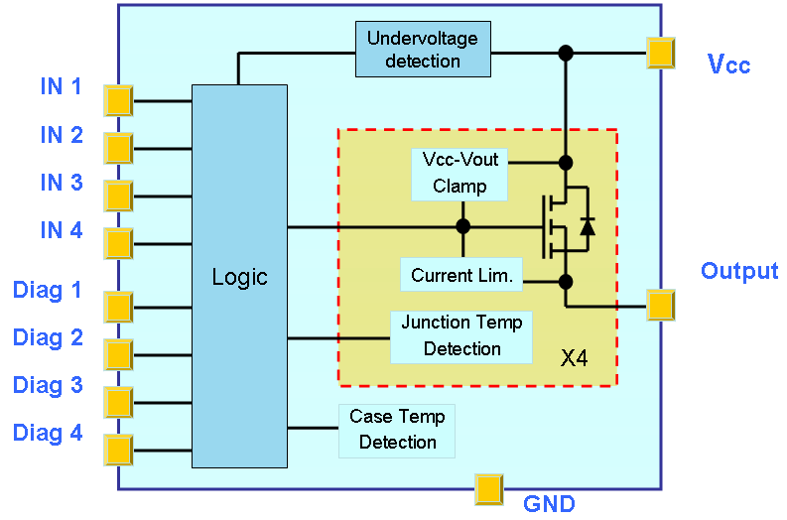
VNI4140 – Normal operation
Vin
Vcc
+
Vout
Iout
Vdiag
LOAD
Notes:
In normal operation, the VIN pin turns ON the MOS when it has a high status and the current flows through the load.

Slide 8
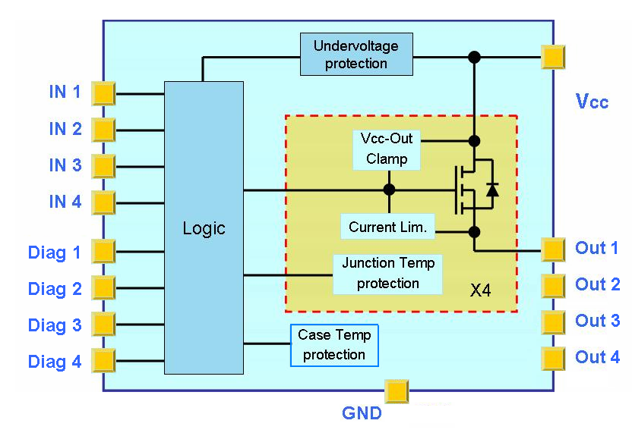
Features: Paralleling the Outputs
Vcc
+
VNI4140K-32
4 Channels in Parallel
Ilim typ. 5,2A
VNI4140K-32
2 Channels in Parallel
Ilim typ. 2,6A
LOAD
Notes:
The VNI4140 is a 4 channel IPS whose outputs can be put in parallel. This will be done with the following purpose
Increase the current in the load
Decrease by a factor of 4 the total RDSon and hence, decrease the power dissipation for the same amount of current.

Slide 9
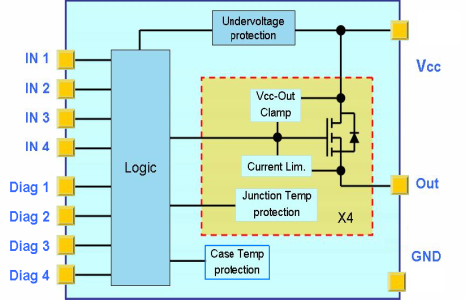
Short-circuit & Over temperature
V_{CC}
V_{IN}
t
I_{OUT}
...
Active!
t
T_{JSD}
...
T_{JR}
T_{J}
t
T_{CSD}
Allows to decrease the total RMS current in the event of a short circuit
T_{CR}
...
t
V_{DIAG}
...
t
Notes:
The VNI4140 has 5 temperatures sensors. One junction temperature for each channel and a case temperature sensor.
Each channel is independent, that means if a channel is turned off because the junction temperature is too high on this given channel, the 2nd channel continues to work.
An over temperature (Junction or case) put the diag pin to low. In the event of a case over temperature, all the channels will be switched off even if the junction temperature is below the limit.
A short circuit condition increases the current and then the temperature, turning off the device.
This technic allows to decrease the RMS current (and hence the energy/heat) to dissipate.

Slide 10
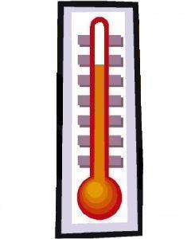
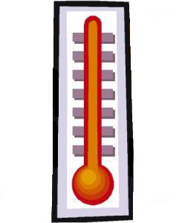
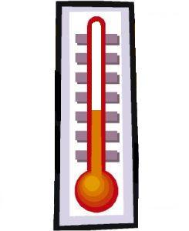
Features: No simultaneous restart in Over temperature
Vcc
+
Tj = 150°C
TC<110°C
TC > 125°C
Iout
Vdiag
4
3
Iout
2
t
1
t
Notes:
When an over temperature for the case occurred, all the channels are switched off. In order to avoid a new shut down when the device cooled off, the outputs channels are turned on step by step. Turning on the 4 channels at the same time, would be probably trigger a new over temperature shut down.

Slide 11
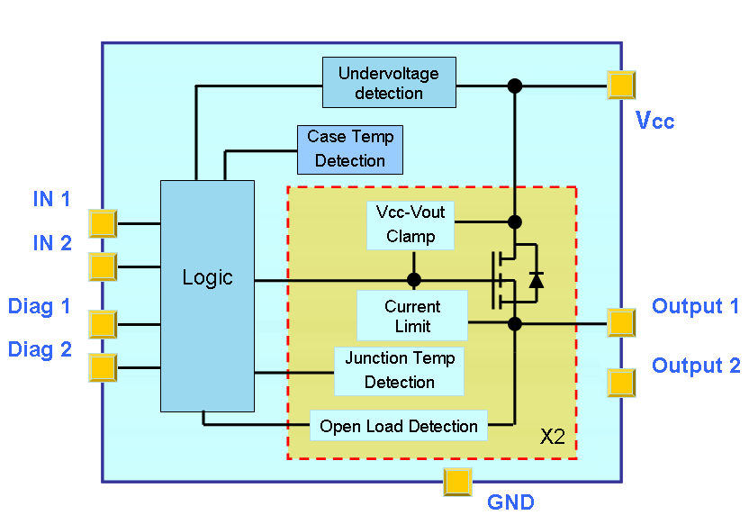
Fast Demagnetization
+
Vcc
Vin
Vout
R_{Pu1}
Iout
INDUCTIVE
LOAD
Notes:
When the VNI4140 drives an inductive load, the energy stored in the load must be dissipated very efficiently. The VNI2140 integrates a zener diode between the Out and the Vcc that will clamp the voltage at 50V. In other words, when the transistor is turned off, the voltage between Vcc and Out can go up to 50V. If Vcc=24V, the Vout can be up to -26V, allowing a fast decrease of the current in the inductive load (as U= L di/dt)

Slide 12
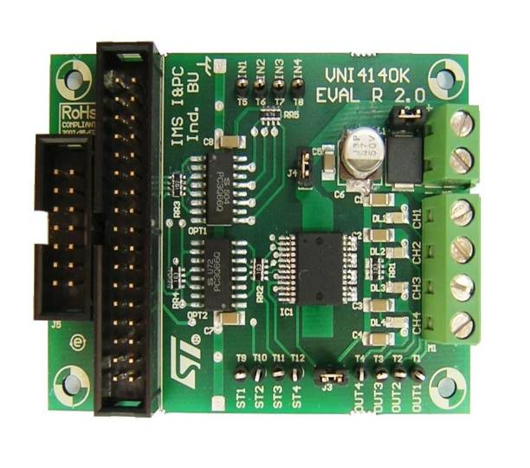
VNI4140K Reference Board Application Circuit (Factory Automation)
Filter for bus inductance effect.,
make supply voltage stable and
avoid undervoltage shut down
Protection for IEC 61000-4-5
Surge test
suggested SM15Txxx
Optional protection for Vcc disconnection.
EMC Filter
Vcc =24V
+
47μF
100nF
Protection against IEC 61000-4-6
Current injection Test
Vin1
Load 1
Vin4
10nF
Load 2
VNI4140K
Diag1
Diag4
Load 4
PROTECTIONS INCLUDED IN THE DEVICE:
IEC 61000-4-2 ESD Test better than 2000V Human body model IEC 61000-4-4 Burst Test
Order code:
STEVAL-IFP006V1
Notes:
In the industrial environment, EMC and ESD requirements are very stringent. VNI4140 evalboard meets these requirements

Slide 13
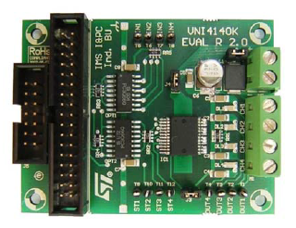
TOOLS: Reference Board + AN
VNI4140K Evalboard
Order code:
STEVAL-IFP006V1

Slide 14
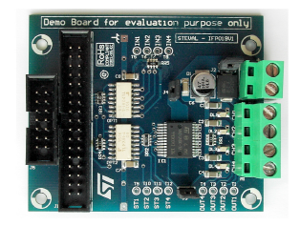
TOOLS: Reference Board + AN
VNI4140K-32 Evalboard
Order code:
STEVAL-IFP019V1

